Slide 1
IBM EMPLOYEE ATTRITION DATA ANALYSIS PROJECT
-Pranita Banavali

Slide 2
What is Data Analysis Using Excel?
Data analysis using Excel involves using Microsoft Excel, a popular spreadsheet software, to analyze and manipulate data in order to extract meaningful insights and make informed decisions.

Slide 3
IBM Employee Data Analysis
Demographics
Turnover Trends
Performance Metrics
Compensation & Benefits
Training & Development
Employee Engagement
Diversity & Inclusion
Workforce Planning
Health & Wellness
Feedback Analysis"

Slide 4
Three Level Of Analysis That We’ve Performed
1.Level 1 Analysis (Univariate Report)
2.Level 2 Analysis (Bivariate Report)
3.Level 3 Analysis (Multivariate Report)

Slide 5
Two Types Of Level 1 Analysis
1.Categorical Analysis
2.Numerical Analysis

Slide 6
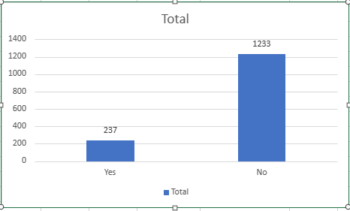
How Many Employees Have Left The Company?
Attrition is categorical type of data which is
nominal.
Interpretation:237 people have left the
Company which forms 16% of overall
data.While 1233 people are still there in company
Which forms 84% of overall data
Reference to Univariate Report

Slide 7
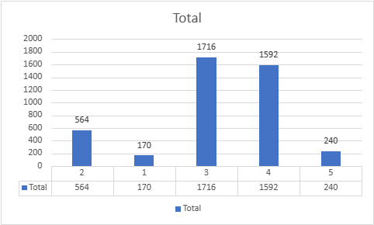
Which Education Category Has Highest Value Count?
Education is categorical type of data which is ordinal.
Interpretation:Education has 5 categories.
1,2,3,4,5.
Category 3 has highest count of
1716 with 40% of overall data.
Reference to Univariate Report

Slide 8
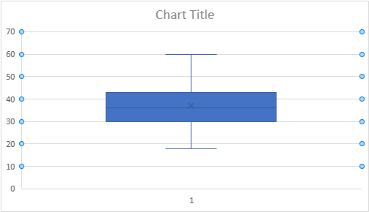
Can You Give Details About Age Of All Employees?
Age is numerical data which is continuous in nature.
Interpretation:For age minimum
value is 18,maximum value is 60,
mean is 36.92,median is 36,mode is 35.
Reference to Univariate Report

Slide 9
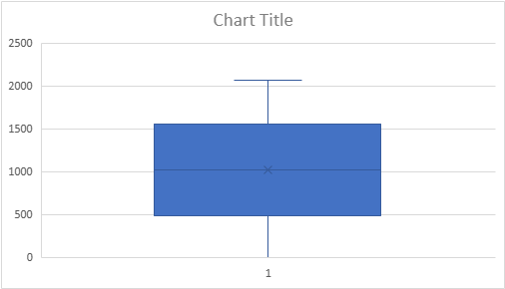
Can You Give Details About Employee Number Of All Employees?
Employee Number is numerical data which is discrete in nature.
Interpretation:Minimum EmployeeNumber is
1,maximum employee number is 2068,
mean employee number is 1024.865,
median of employee number is 1020.5.
Reference to Univariate Report

Slide 10
Types Of Level 2 Analysis
1.Category-Category Analysis
2.Category-Numeric Analysis
3.Numeric-Numeric Analysis

Slide 11
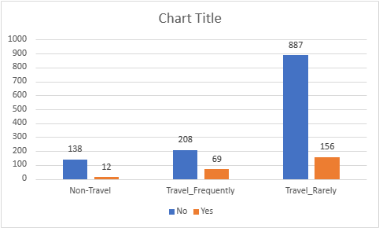
Can You Give Travelling Details Of All Employees?
Category 1 is Attrition and Category 2 is Business Travel
Interpretation:Attrition_BusinessTravel
has 3 categories:Non-Travel,
Travel_Frequently and Travel_Rarely.
Highest Count is of employees who are there in
Company who are travelling rarely is 887.
Reference to Bivariate Report

Slide 12
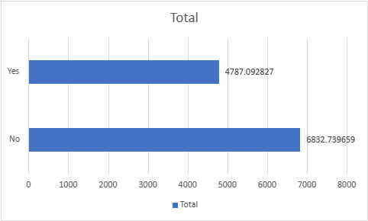
What Is The Average Salary Of Attrited Employees And Those Who Are Working In Company?
Category is Attrition and Numeric is MonthlyIncome
Average Salary Of Attrited Employees is 4787.09 is
Lesser than those who are workking in company which
Is 6832.73
Reference to Bivariate Report

Slide 13
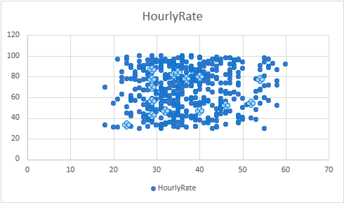
What Is Type Of Correlation Between Age And Hourly Rate?
Numeric 1 is Age and Numeric 2 is Hourly Rate.
Interpretation:There is positive correlation of
0.0242 between age and
hourly rate.
Reference to Bivariate Report

Slide 14
Two Types Of Level 3 Analysis We Have Done
1.Taking 4 categories
2.Taking 3 categories and one numeric

Slide 15
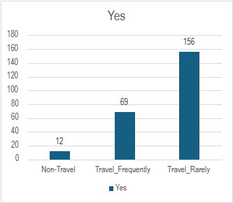
What Are Travelling Details Of Attrited Employees?
4 categories are Attrition,Business Travel,Department and Education
Interpretation:Out of attrited employees highest
number of people are travelling rarely whose value count is 156.
Reference to Multivariate Report

Slide 16
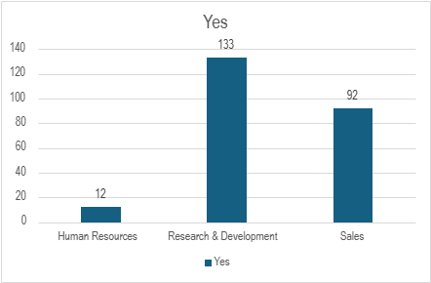
From Which Department Of Compnay Have Highest Number Of Employees Left?
Three Categories are Attrition,Business Travel,Department and one numeric is Age.
Interpretation:Out of attrited attributes highest number
of people were working in research and development
with 133 as value count.
Reference to Multivariate Report

Slide 17
Conclusion Of IBM Employee Data Analysis
1.16% of employees have left the company which is comparatively less since company culture is good and they are paying well.
2.40% of employees have Category 3 education which is highest type of education which can be used for further promotion.
3.Mean Age of Employees is 36.92 which is mostly youth.
4.Highest Count Of Employees Who Are Working In Company Are travelling rarely which is 887.They maybe working from home.
5.Monthly Income Of Attrited Employees is lesser than that of those working in company might be the reason they have left.
6.There is positive correlation between age and hourly rate.

Slide 18
7.156 Attrited Employees were travelling rarely which is highest.
8.Highest Number Of People Working In Reserach And Development have left the company which is 133.

